Slide 1
Reopening of campus
Harold L. Martin, Sr.
Chancellor
Virtual Town Hall
06/04/20

Slide 2
Health and safety protocols and expectations
Melissa Holloway, General Counsel, Legal Affairs
Robert Pompey, vice Chancellor, Business and Finance
Virtual Town Hall
06/04/20

Slide 3
AGGIES SAFER together
Health and Safety
Universal Protocols For A Safe Return in Fall 2020
Compliance with CDC, State of NC, and UNC System guidance
Shared Community Standards and Expectations
Symptoms and Self-Monitoring
Social Distancing/Physical Distancing
Face Coverings/Masks (PPE)
Cleaning/Disinfection
Personal Hygiene

Slide 4
Shared community standards, expectations, and responsibilities
Health and Safety
COVID-19 is highly transmissible and can be spread by people who don’t know they have the disease and/or are not symptomatic.
Universal precautions are required to prevent the transmission even for those who are not exhibiting or at higher risk.
Individual responsibility for implementing recommended personal-level actions is of utmost importance.

Slide 5
Symptom monitoring
Health and Safety
Conduct symptom monitoring (self-checks) every day before reporting to campus.
If you feel sick, stay home, and seek assistance from the Student Health Center.
The Director of Student Health Services will make recommendations about student testing as needed.
Rooms have been reserved for isolation and quarantine purposes, should one or more students test positive for COVID-19 or become exposed to someone who tests positive.

Slide 6
Personal hygiene
Health and Safety
Students, faculty and staff should wash hands often with soap and water for at least 20 seconds, especially after being in a public place or using one’s hands to catch a cough or sneeze.
Sanitizing stations will be located throughout campus for easy access and usage, containing sanitizer with at least 60% alcohol.

Slide 7
Social/Physical Distancing
Health and Safety
Social distancing practices, which involve limiting direct physical contact with others to help stop or slow the spread of the virus, will include staying at least six (6) feet apart, avoiding groups and staying out of crowded spaces.
Classrooms, conference rooms, auditoriums, stadiums, etc. will be configured to promote social distancing.
Directional signage will be posted to promote one-way paths, where practical.
Visual cues will be placed in areas where lines are required to maintain social distancing.

Slide 8
FACE MASKS/COVERINGS
Health and Safety
Face coverings are critical in minimizing the risk to others.
Students, faculty, and staff should and are strongly encouraged to wear masks or face coverings when unable to maintain social distancing as described above, including during classes.
Students, faculty, and staff should bring their own face coverings; however the university will supply an A&T branded cloth face covering to all students, faculty, and staff during the fall reopening. A limited supply of disposable masks will be available.

Slide 9
Campus facilities
Health and Safety
Facilities team reported to work on June 1, 2020 to begin cleaning and sanitation efforts.
Clean in accordance with CDC guidelines which includes a deep cleaning of all buildings.
Utilize registered EPA disinfectant products that meet criteria for use against the COVID-19.
All personnel will use gloves and face coverings, especially when social distancing is not possible.
Plexiglass installation

Slide 10
Cleaning/disinfection
Health and Safety
Surfaces with high touch points, such as classrooms, corridors, restrooms and other highly trafficked areas will receive multiple cleanings each day.
Students should bring sanitizer and other supplies to use in their living spaces, to help keep their personal areas clean and disinfected.
Sanitizing wipes will be available near classrooms, computer labs, shared study spaces

Slide 11
Academic calendar, instruction, and classroom safety
Health and Safety
Adjusted Fall Academic Calendar
Fall Orientation
Smaller Class Sizes
In-Person vs. Remote
Social Distancing
Lab and Common Workspace Safety
Other Remote Measures to Decrease Campus Density (i.e. virtual meetings)

Slide 12
Course delivery
Beryl McEwen
Provost and Executive Vice Chancellor, Academic Affairs
Virtual Town Hall
06/04/20

Slide 13
On campus instruction
Course Delivery
Face-to-face
Smaller class sizes for physical distancing
Mask during classes
Entrances and exits separated
Professors encouraged to limit roaming
Hybrid
Blend of face-to-face and online/remote delivery
Access to professors at least once per week

Slide 14
Distance education
Course Delivery
Online
Fully asynchronous
Synchronous elements
Remote Advising
Remote Access to all campus services
Library
Accessibility Resources
Writing Center
Tutoring
Counseling

Slide 15
Housing and residence life and student engagement
Dr. Melody Pierce
Vice Chancellor, Student Affairs
Virtual Town Hall
06/04/20

Slide 16
Housing and residence Life
Student Affairs
We will implement a tiered move-in process for select student groups. Each group will have a designated date and time:
>Special Populations: June 24th through August 6th >New Students: August 7th through 9th >Continuing Students: August 14th through 18th
All residence halls will receive thorough cleaning 7 days per week, multiple times per day.
Students residing together as roommates are considered a “family unit” and will be expected to practice the proper precautions to maintain a healthy environment (3 Ws).

Slide 17
Housing and residence Life
Student Affairs
We will modify housing numbers to accommodate restroom health and safety.
Will reduce the number of beds in older, traditional halls to protect health from doubles to singles, converting portions of Cooper, Vanstory, Murrow, Holland and Curtis Halls from doubles to singles.
We will provide a list of additional resources for students who can’t get an on-campus or off-campus A&T assignment.

Slide 18
Housing and residence Life
Student Affairs
Visitation for the Fall 2020 semester is restricted and common area (lobbies, study rooms, computer labs, laundry facilities, etc.) capacities within residence halls will be limited.
Residence hall expectations will be communicated with each student upon arrival during a series of virtual residence hall meetings facilitated by Housing and Residence Life staff members.
A location has been identified for quarantine use, if a student presents symptoms. Students are expected to relocate to this area during testing. Students testing positive are expected to return to their permanent home address as soon as possible. The quarantine area will be sanitized multiple times a day on a weekly schedule.

Slide 19
DINING and retail operations
Student Affairs
Seating capacities in dining facilities will be reduced to 50% of the maximum occupancy across campus.
Dining areas will align with physical distancing guidelines including limited seating, six-feet spacing, adjusted flows of traffic, to-go options, contactless and touchless payment options, and restricting self-serve options.
We will expand sanitation measures in all locations and provide additional cleaning services between meal hours.

Slide 20
Student Affairs
STUDENT CENTER AND CAMPUS RECREATION CENTER
In collaboration with Dining Services, the Student Center will modify hours of operation: >Monday-Friday: 8am-10pm >Saturday: 12pm-10pm >Sunday: 2pm-10pm
Flow of traffic will be adjusted to align with physical distancing guidelines and signage will be placed in highly visible locations throughout the building.
Extensive cleaning and disinfectant measures will be implemented with hourly sanitation throughout the facility.
External individual and group event reservations are restricted for the Fall 2020 semester.
Capacities for internal events will be limited and room layouts will reflect physical distancing guidelines at all times.

Slide 21
Student Affairs
STUDENT engagement
Students will have access to virtual “return to campus trainings”. The trainings will include guidelines for maintaining a healthy environment.
Students are expected to review training materials prior to arrival on campus.
We will restrict large gatherings for the Fall 2020 semester and only permit gatherings of 10 indoors or 25 outdoors.
Events larger than the aforementioned should transition to an online format or postpone to Spring 2021 (i.e. Greek life activities, socials, comedy show, etc.)
Students are expected to follow physical distancing guidelines for all social gatherings.
Use of Greek plots is permitted, with the expectation of physical distancing and use of masks.

Slide 22
athletics
Earl Hilton
Director, Intercollegiate Athletics
Virtual Town Hall
06/04/20

Slide 23
Athletics
Why?
How?
- Guidelines for students generally
- NCAA guidance
- Testing
- Conditioning / Practice
- Calendar

Slide 24
Athletics
Football – Game Day
Health and Safety
- Social Distancing and Masks
- Ingress / Egress
- Tailgating
- Concessions
- Tents / Beer Garden
- Skybox

Slide 25
Athletics
Proposed seating plan – truist stadium
Row | 1 | 2 | 3 | 4 | 5 | 6 | 7 | 8 | 9 | 10 | 11 | 12 | 13 | 14 | 15 | 16 | 17 | Row
34 | 1 | 2 | 3 | 4 | 5 | 6 | 7 | 8 | 9 | 10 | 11 | 12 | 13 | 14 | 15 | 16 | 17 | 34
33 | 1 | 2 | 3 | 4 | 5 | 6 | 7 | 8 | 9 | 10 | 11 | 12 | 13 | 14 | 15 | 16 | 17 | 33
32 | 1 | 2 | 3 | 4 | 5 | 6 | 7 | 8 | 9 | 10 | 11 | 12 | 13 | 14 | 15 | 16 | 17 | 32
31 | 1 | 2 | 3 | 4 | 5 | 6 | 7 | 8 | 9 | 10 | 11 | 12 | 13 | 14 | 15 | 16 | 17 | 31
30 | 1 | 2 | 3 | 4 | 5 | 6 | 7 | 8 | 9 | 10 | 11 | 12 | 13 | 14 | 15 | 16 | 17 | 30
29 | 1 | 2 | 3 | 4 | 5 | 6 | 7 | 8 | 9 | 10 | 11 | 12 | 13 | 14 | 15 | 16 | 17 | 29
28 | 1 | 2 | 3 | 4 | 5 | 6 | 7 | 8 | 9 | 10 | 11 | 12 | 13 | 14 | 15 | 16 | 17 | 28
27 | 1 | 2 | 3 | 4 | 5 | 6 | 7 | 8 | 9 | 10 | 11 | 12 | 13 | 14 | 15 | 16 | 17 | 27
26 | 1 | 2 | 3 | 4 | 5 | 6 | 7 | 8 | 9 | 10 | 11 | 12 | 13 | 14 | 15 | 16 | 17 | 26
25 | 1 | 2 | 3 | 4 | 5 | 6 | 7 | 8 | 9 | 10 | 11 | 12 | 13 | 14 | 15 | 16 | 17 | 25
24 | 1 | 2 | 3 | 4 | 5 | 6 | 7 | 8 | 9 | 10 | 11 | 12 | 13 | 14 | 15 | 16 | 17 | 24
23 | 1 | 2 | 3 | 4 | 5 | 6 | 7 | 8 | 9 | 10 | 11 | 12 | 13 | 14 | 15 | 16 | 17 | 23
22 | 1 | 2 | 3 | 4 | 5 | 6 | 7 | 8 | 9 | 10 | 11 | 12 | 13 | 14 | 15 | 16 | 17 | 22
21 | 1 | 2 | 3 | 4 | 5 | 6 | 7 | 8 | 9 | 10 | 11 | 12 | 13 | 14 | 15 | 16 | 17 | 21
20 | 1 | 2 | 3 | 4 | 5 | 6 | 7 | 8 | 9 | 10 | 11 | 12 | 13 | 14 | 15 | 16 | 17 | 20
19 | 1 | 2 | 3 | 4 | 5 | 6 | 7 | 8 | 9 | 10 | 11 | 12 | 13 | 14 | 15 | 16 | 17 | 19
18 | 1 | 2 | 3 | 4 | 5 | 6 | 7 | 8 | 9 | 10 | 11 | 12 | 13 | 14 | 15 | 16 | 17 | 18
17 | 1 | 2 | 3 | 4 | 5 | 6 | 7 | 8 | 9 | 10 | 11 | 12 | 13 | 14 | 15 | 16 | 17 | 17
16 | 1 | 2 | 3 | 4 | 5 | 6 | 7 | 8 | 9 | 10 | 11 | 12 | 13 | 14 | 15 | 16 | 17 | 16
15 | 1 | 2 | 3 | 4 | 5 | 6 | 7 | 8 | 9 | 10 | 11 | 12 | 13 | 14 | 15 | 16 | 17 | 15
14 | 1 | 2 | 3 | 4 | 5 | 6 | 7 | 8 | 9 | 10 | 11 | 12 | 13 | 14 | 15 | 16 | 17 | 14
13 | 1 | 2 | 3 | 4 | 5 | 6 | 7 | 8 | 9 | 10 | 11 | 12 | 13 | 14 | 15 | 16 | 17 | 13
12 | 1 | 2 | 3 | 4 | 5 | 6 | 7 | 8 | 9 | 10 | 11 | 12 | 13 | 14 | 15 | 16 | 17 | 12
11 | 1 | 2 | 3 | 4 | 5 | 6 | 7 | 8 | 9 | 10 | 11 | 12 | 13 | 14 | 15 | 16 | 17 | 11
10 | 1 | 2 | 3 | 4 | 5 | 6 | 7 | 8 | 9 | 10 | 11 | 12 | 13 | 14 | 15 | 16 | 17 | 10
9 | 1 | 2 | 3 | 4 | 5 | 6 | 7 | 8 | 9 | 10 | 11 | 12 | 13 | 14 | 15 | 16 | 17 | 9
8 | 1 | 2 | 3 | 4 | 5 | 6 | 7 | 8 | 9 | 10 | 11 | 12 | 13 | 14 | 15 | 16 | 17 | 8
7 | 1 | 2 | 3 | 4 | 5 | 6 | 7 | 8 | 9 | 10 | 11 | 12 | 13 | 14 | 15 | 16 | 17 | 7
6 | 1 | 2 | 3 | 4 | 5 | 6 | 7 | 8 | 9 | 10 | 11 | 12 | 13 | 14 | 15 | 16 | 17 | 6
5 | 1 | 2 | 3 | 4 | 5 | 6 | 7 | 8 | 9 | 10 | 11 | 12 | 13 | 14 | 15 | 16 | 17 | 5
4 | 1 | 2 | 3 | 4 | 5 | 6 | 7 | 8 | 9 | 10 | 11 | 12 | 13 | 14 | 15 | 16 | 17 | 4
3 | 1 | 2 | 3 | 4 | 5 | 6 | 7 | 8 | 9 | 10 | 11 | 12 | 13 | 14 | 15 | 16 | 17 | 3
2 | 1 | 2 | 3 | 4 | 5 | 6 | 7 | 8 | 9 | 10 | 11 | 12 | 13 | 14 | 15 | 16 | 17 | 2
1 | 1 | 2 | 3 | 4 | 5 | 6 | 7 | 8 | 9 | 10 | 11 | 12 | 13 | 14 | 15 | 16 | 17 | 1
3 - 6’ Seated Distancing
3’ (two seats) between groups sitting on same rows
Seating every other row
41% utilization-allows for various seated groups
All seats are reserved
~7800 seats available

Slide 26
Athletics - Stadium Ingress / Egress

Slide 27
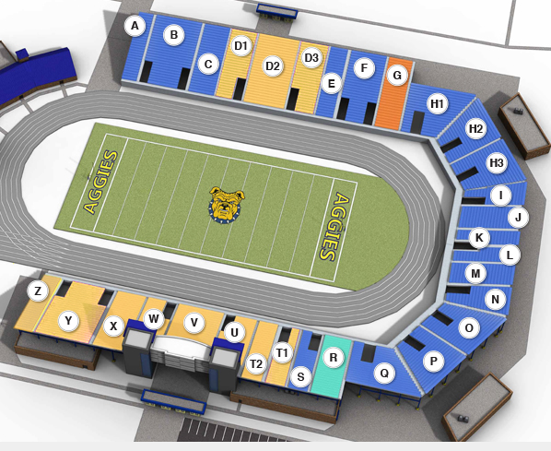
Athletics - Seating
Every seat reserved
Season Books - $198
Premium reserved - $45
Other reserved - $35

Slide 28
Athletics
concessions
Plexiglas will be installed at each concession stand counter
All food mobile carts will have Plexiglas installed
Provide limited menu options
Provide single-use condiment packets
Floor decals, stanchions with signage (6 ft. distance), posters at each concession stand indicating appropriate social distance
Use stanchions to que and separate lines
Eliminate hawking services
Hands-free sanitizing stands at all locations
All surface areas will be wiped down, cleaned and sanitized every 30 minutes at each location
All employee will wear masks and gloves as outlined per the state/regulatory agencies’ (health department) requirements
Visual aids to promote proper personal hygiene and safety posted in each concession stand

Slide 29
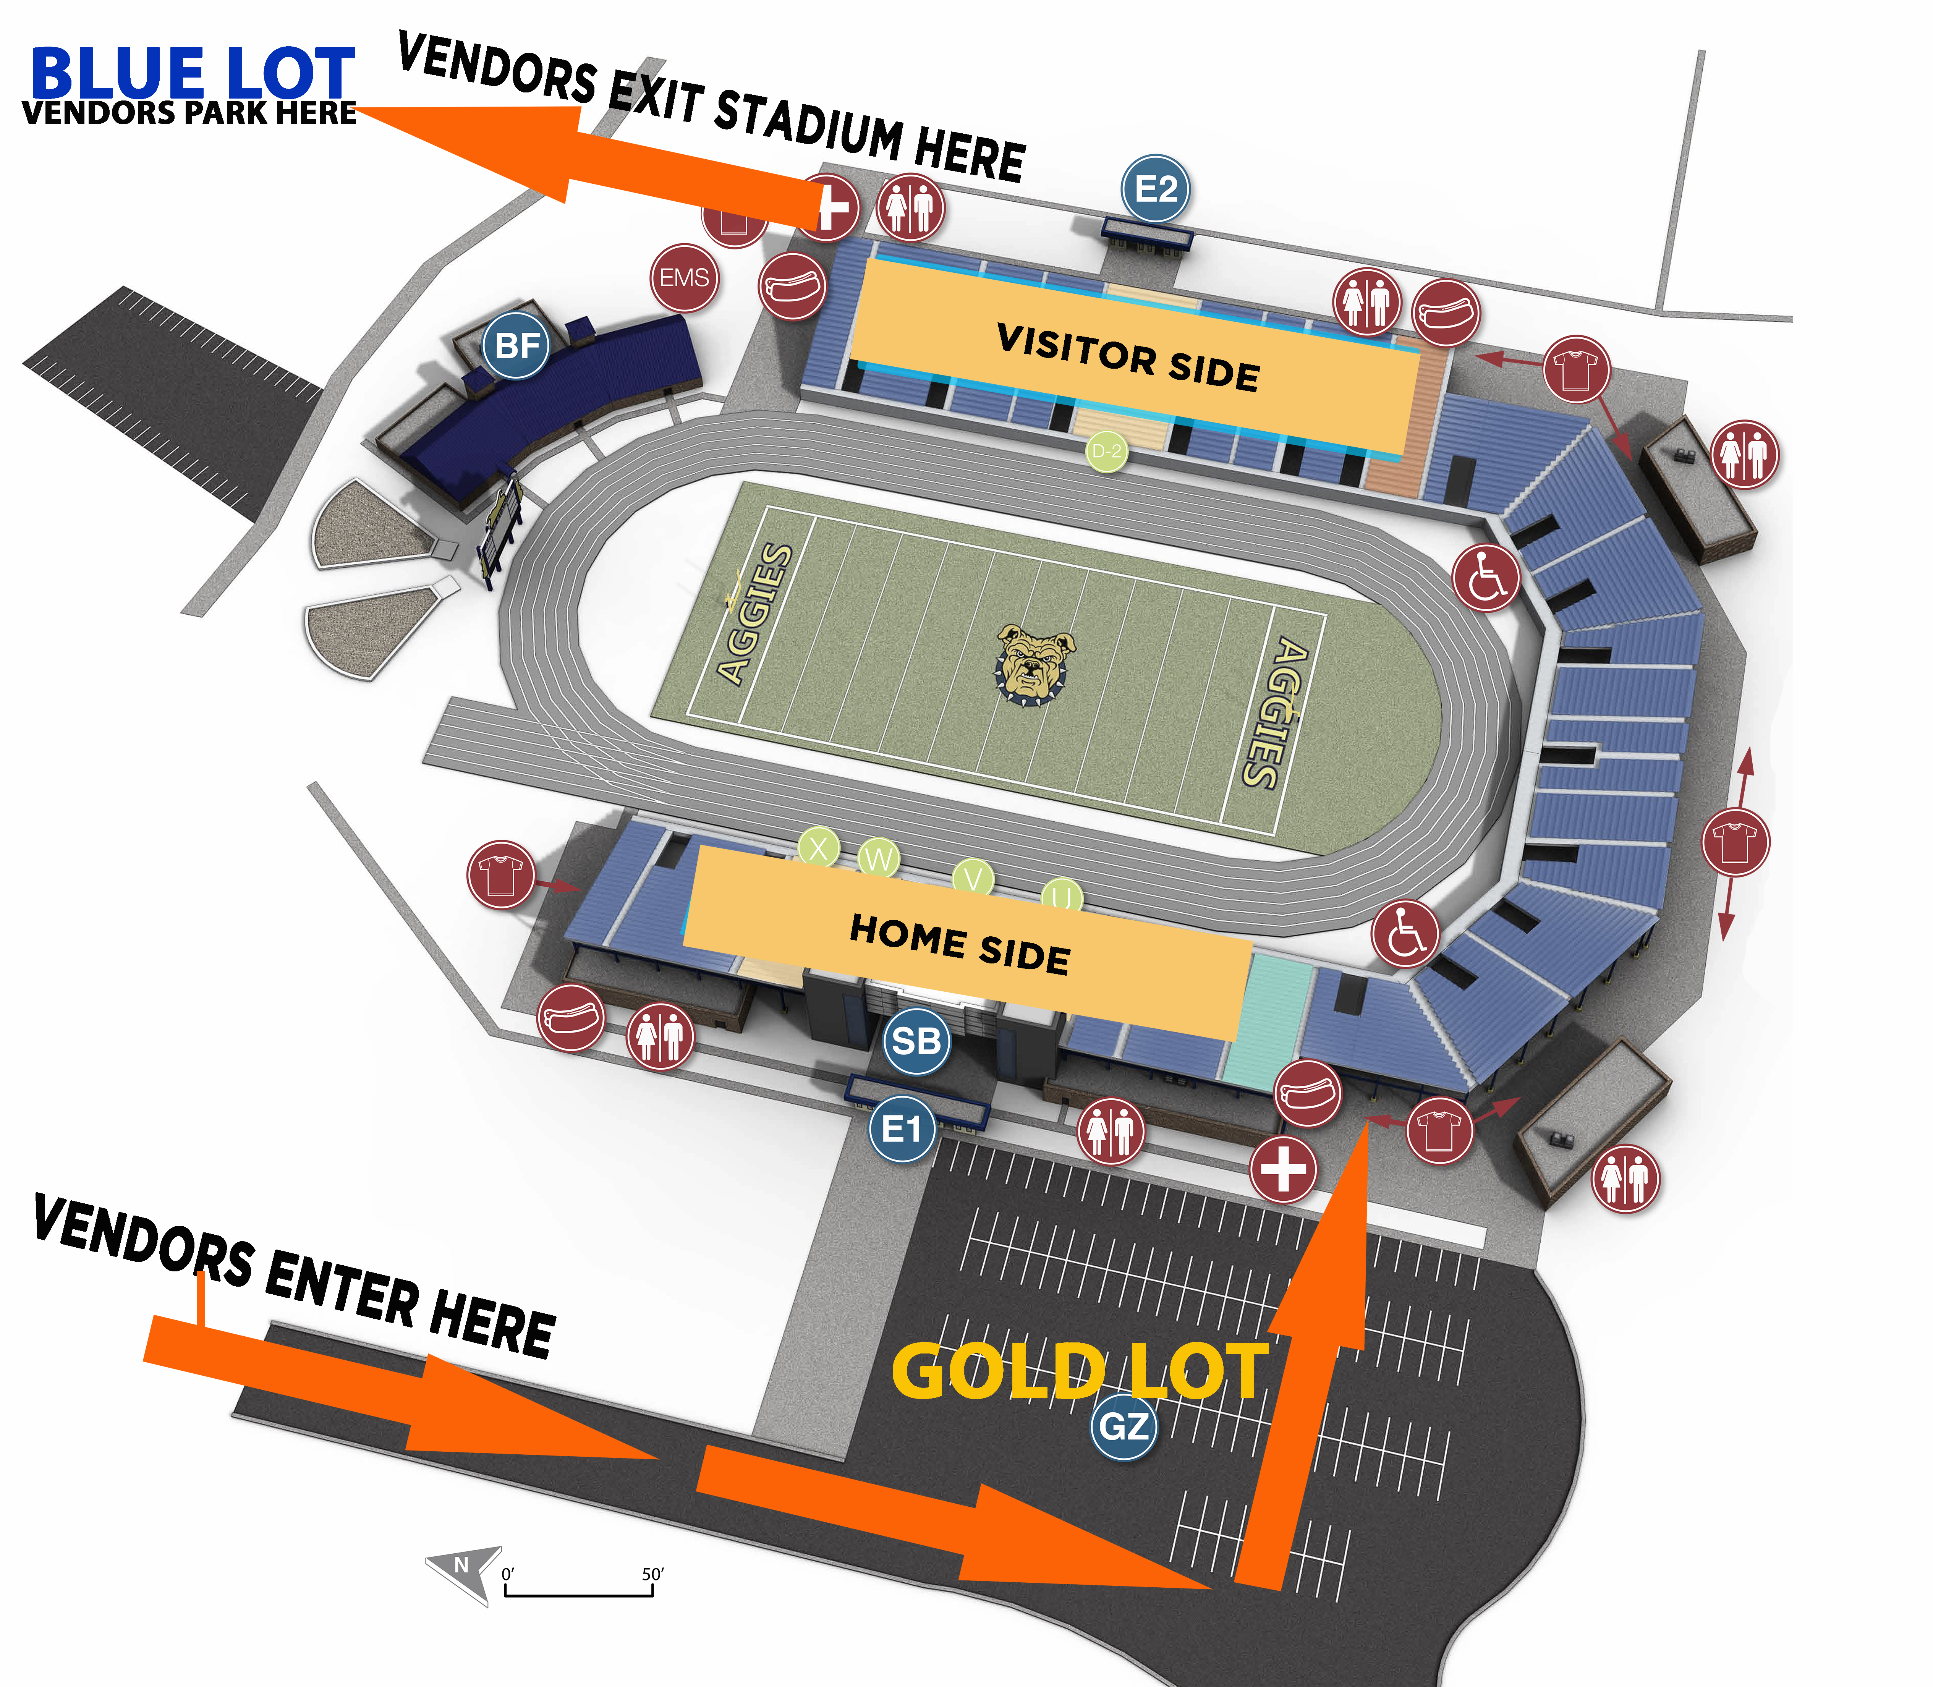
Athletics
SPACE # | VENDOR NAME
1 | Athletics
2
3 | BEER TENT
4 | Bookstore
5 | Paid Vendor
6
7 | Paid Vendor
8
9 | Paid Vendor
9A
9B | Paid Vendor
9C
9D | Paid Vendor
HORSESHOE
10A
10B | Paid Vendor
10C
10D | Paid Vendor
10
11 | Paid Vendor
12
13 | Paid Vendor
14 | GENERATOR
15
16
17 | Paid Vendor
18
18A | Paid Vendor
19
VISITOR
20 | Paid Vendor
20A
20B | Paid Vendor
21
22* | Paid Vendor
23/24
25/26 | Paid Vendor
27
28/29 | Paid Vendor
30
34/35 | Paid Vendor
36
37 | Paid Vendor
Vending/merchandising
Every other space at Stadium will be used for vending purposes. Of 38 potential spaces, only 18 will be in use.
Customers are expected to maintain six feet of distance between themselves and others.
For their protection and the protection of others, vendors will be required to operate with disposable gloves, facial masks and a supply of hand sanitizer or hand wipes.

Slide 30
Open discussion
Harold L. Martin, Sr.
Chancellor
Virtual Town Hall
06/04/20

Slide 31
Thank you

